Slide 1




PirateShip: Append-Only Ledger with (Mostly) Trusted Execution Environments
Shubham Mishra <shubham_mishra@berkeley.edu>
Chawinphat Tankuranand
Natacha Crooks
Heidi Howard
Markus Kuppe*
* Work done while at Microsoft

Slide 2

Distributed Trust
Deposit
(A, 5)
Deposit
(B, 10)
Transfer
(A, B, 3)
Transfer
(B, A, 6)

Slide 3

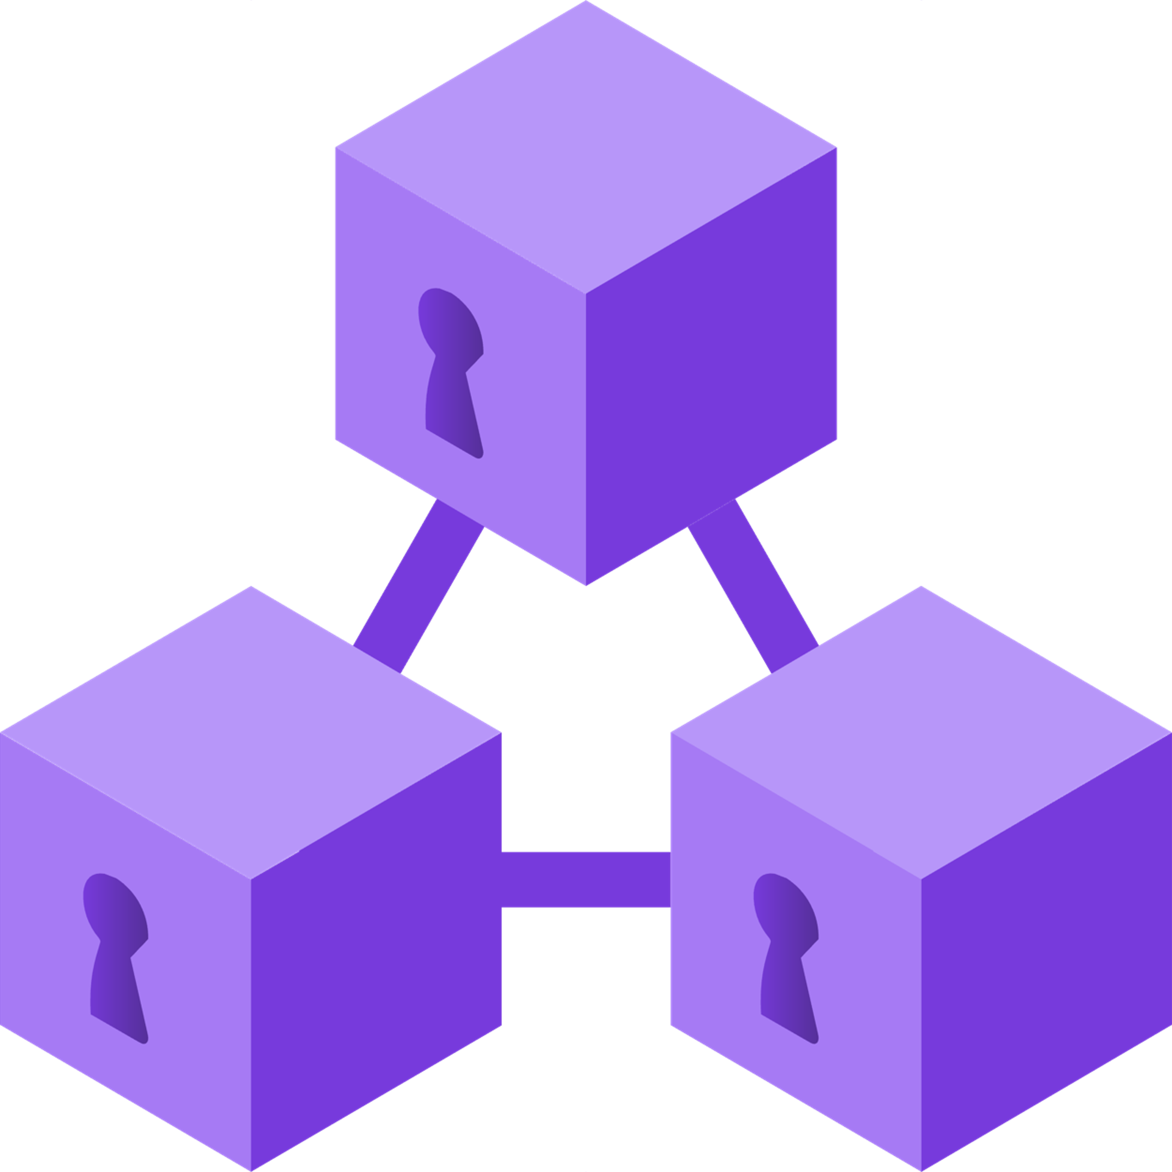
Distributed Trust
Azure Confidential Ledger

Slide 4

System Assumptions
Minority Compromises

Slide 5
System Assumptions
Minority Compromises
Independent Failures

Slide 6



TEEs raise the barrier for attacks
Integrity protection ⇒
Minority Compromises
Almost no
^
Confidentiality ⇒
Independent Failures

Slide 7
But…
Do TEEs remain secure forever?

Slide 8
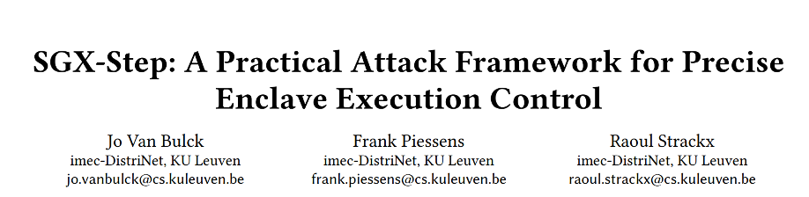
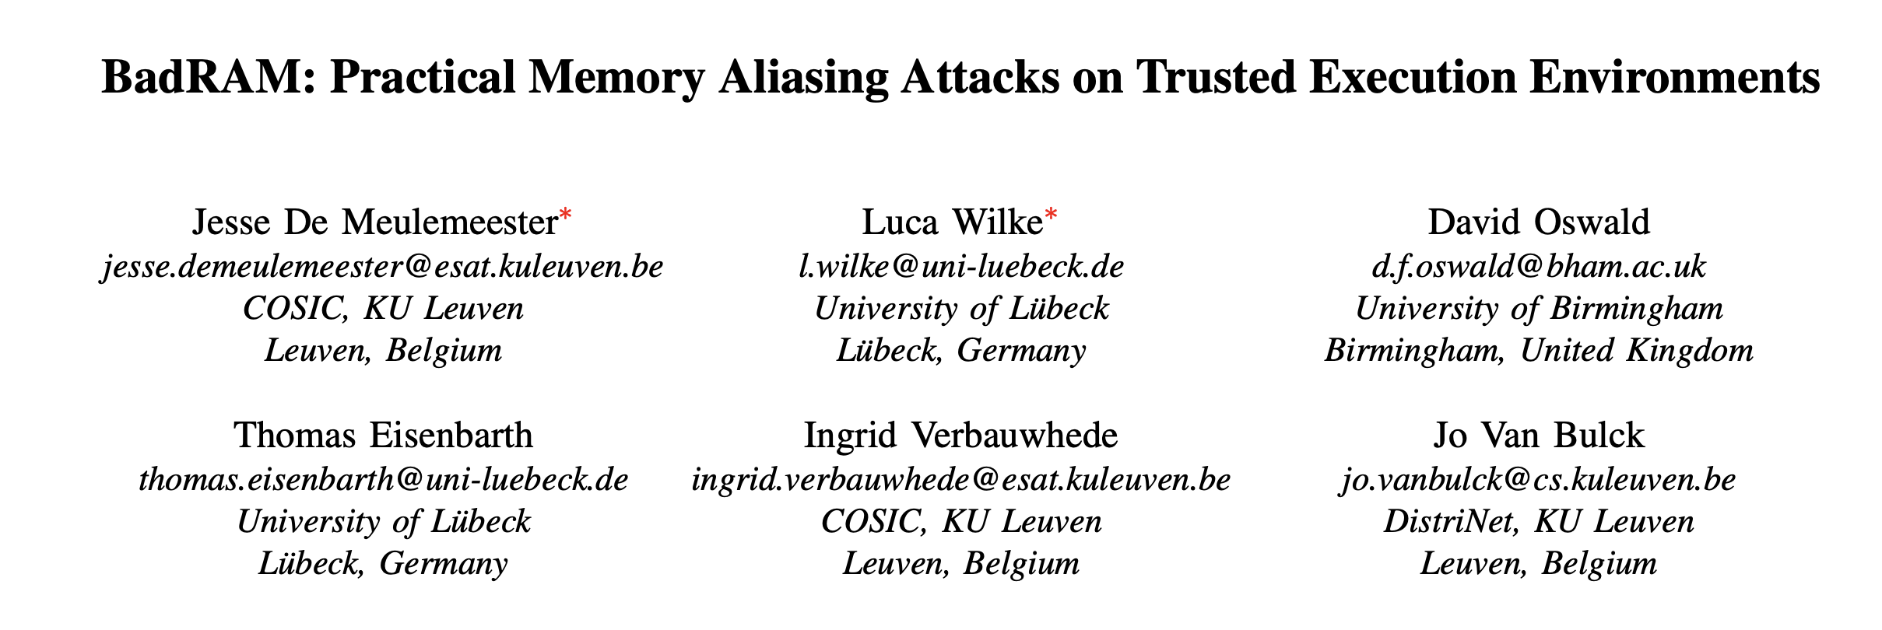
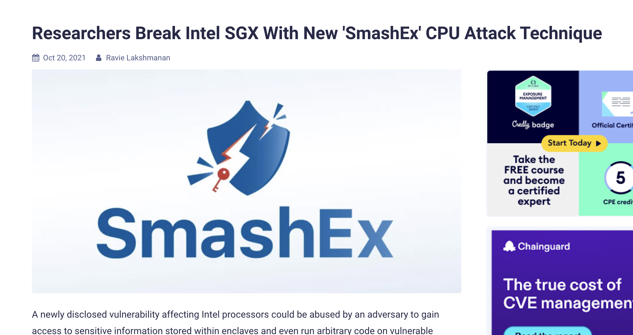
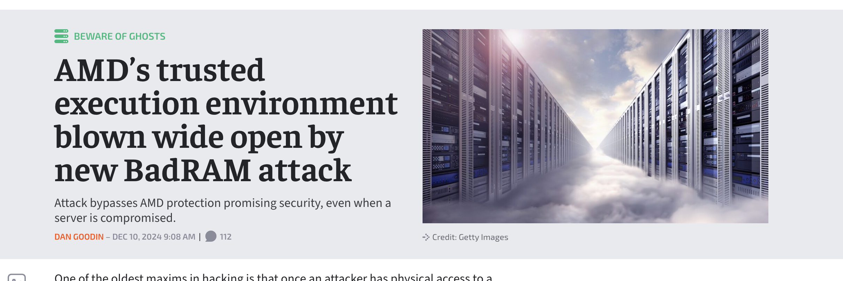
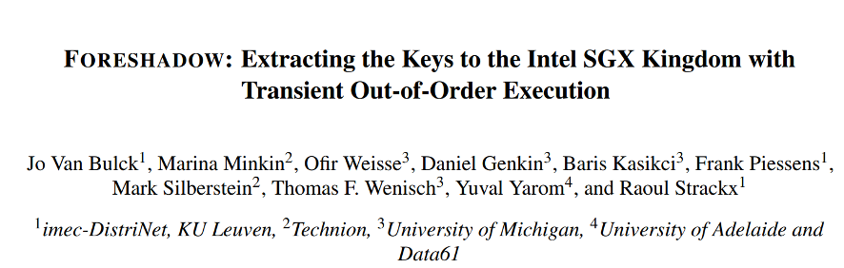
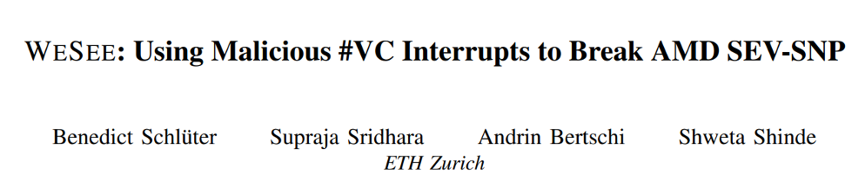
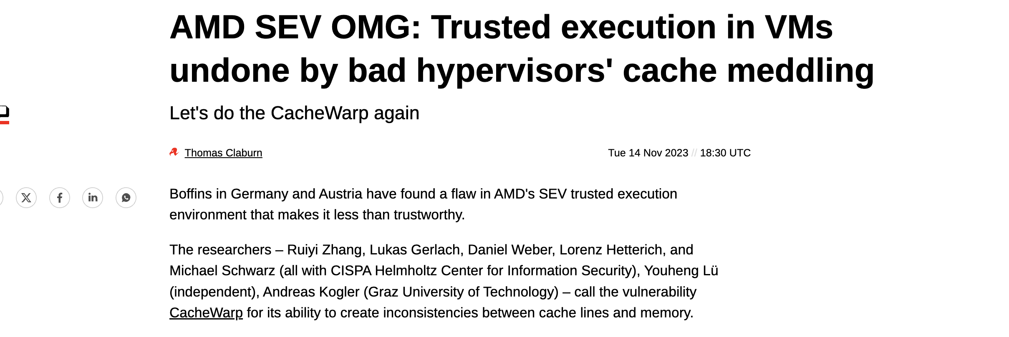
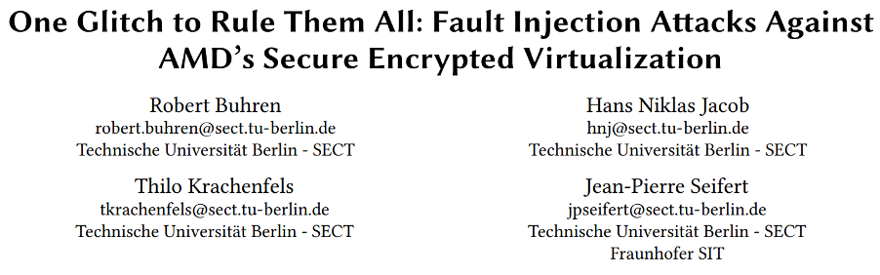
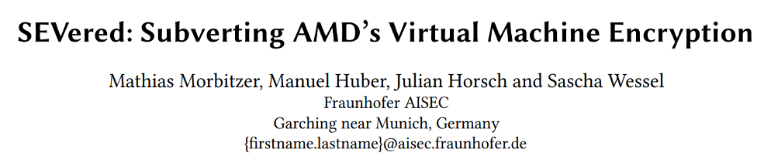

Slide 10
Impact Spectrum
Model Serving
Model Training
Analytics
Key Management

Slide 11
Impact Spectrum: Within an Application
Credit Score Update
High $$ Transfer
Low $$ Transfer
Account Deletion

Slide 12
What do we need in a ledger?
①
Understands the reality of TEE compromises.
②
Offers flexible protection.
No ledger provides both 😔

Slide 13
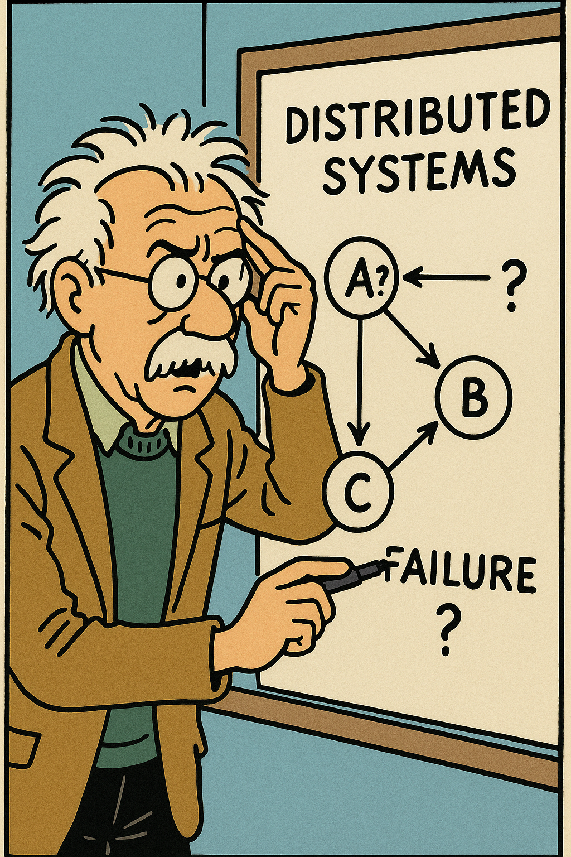
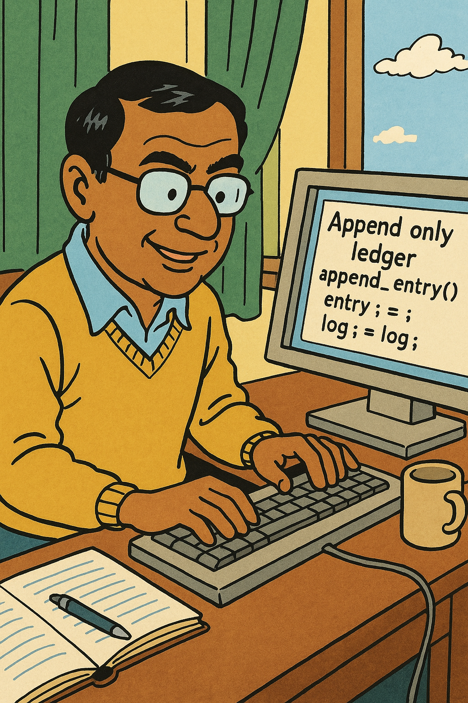
What can we do?
Correlated Failures
Rare TEE Compromises
Heterogenous Cluster
Auditing
Platform Fault Tolerance
PirateShip

Slide 14
What can we do?
Correlated Failures
Rare TEE Compromises
Heterogenous Cluster
Auditing
Platform Fault Tolerance
PirateShip

Slide 15
Platform Fault Tolerance (PFT)
Failures
Independent Crashes
Correlated Compromises
Platforms Capture Correlation

Slide 16

Platform is an Independent Failure Domain

Slide 17

Platform is an Independent Failure Domain

Slide 18


Platform is an Independent Failure Domain

Slide 19
PFT Determines Safe Configurations
Safe up to 2 crashes + 1 platform compromise

Slide 20
What can we do?
Correlated Failures
Rare TEE Compromises
Heterogenous Cluster
Auditing
Platform Fault Tolerance
PirateShip

Slide 21

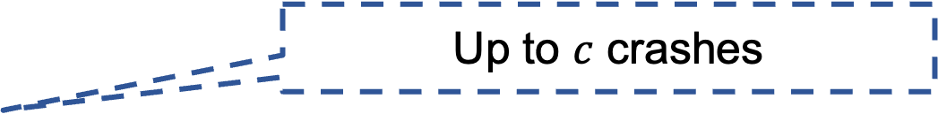
Dual notions of confirmation
Commit
Up to $c$ crashes
Audit
Up to $f_{p}$TEE platform failures

Slide 22
Dual notions of confirmation
Audit
Commit
Audited
Committed
Uncommitted
A
B
C
D
Audit/Commit
A
B
C
D
E
F
time
Audit
Commit
A
B
C
D
E
F
G
PirateShip lets YOU choose the max allowed gap

Slide 23
Dual notions of confirmation
PirateShip lets YOU decide when to execute
PirateShip lets YOU choose who pays the cost!
Audit
Commit
Audited
Committed
Uncommitted
A
B
C
D
E
F
G
Audit
Commit
A
B
C
D
E
F
time
On benign crashes
Audit / Commit
A
B
C
D
On rare TEE failures

Slide 24
Impact Spectrum
Credit Score Update
High $$ Transfer
Low $$ Transfer
Account Deletion
PirateShip lets YOU choose whether to pay the cost!

Slide 25
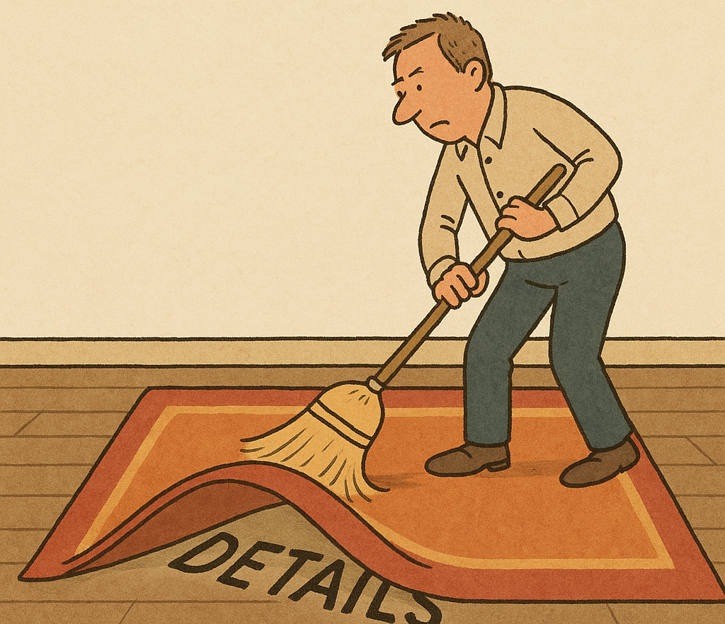

Secret Sauce
Byzantine Fault Tolerance
Audit Logic
Byzantine Fault Tolerance
Byzantine Fault Tolerance
Audit Logic
Audit Logic
Byzantine Fault Tolerance
Audit Logic
Crash Fault Tolerance
Current Ledgers

Slide 26
Performance
13x

Slide 27

Conclusion
Questions?
shubham_mishra@berkeley.edu
Platform Fault Tolerance
Realistic model of TEE-based clusters
PirateShip
High performance PFT Ledger
Audit
Commit
A
B
C
D
E
F
G

